Slide 1
Drupal Basics
Santosh Kalwar
(18-19.08)

Slide 2
Drupal Recap
What did we study last week?
What is CMS?
What is open source?
What is Drupal
Who started it, and who runs it?
How much does Drupal cost?
What does Drupal mean?
Why we should choose Drupal?
We installed Drupal 9 using Lando
Who have not yet installed it (let us fix that first)
Problems / Issues

Slide 3
Drupal Topics
Lando commands
Practices 1-12
Basic drupal front page
Understanding Drupal terminologies and concepts
Drupal concepts and theory
YAML
Twig
Read the Docs
Structure of a Theme
Creating a very simple custom theme

Slide 4
Lando commands
Lando commands
lando start
lando stop
lando info
lando drush
lando drush cc
lando drush cache-rebuild
lando logs
lando composer
lando composer require drupal/module-name
lando composer remove drupal/module-name

Slide 5
Practice 1: Exploration of Drupal Source Code
Read the source code structure of Drupal 9
Try to find the modules folder
In which folder will you create your module?
Where should you create a “custom” module in Drupal?
Browse through different folders to see how this source code is written in
Read composer.json file
Why do you think we have empty “modules” and “themes” folders?

Slide 6
Practice 2: Modify the front page of Drupal
Explore your newly created Drupal site
Change theme (appearance->Set as default)
Change logo name (configuration->basic site settings->settings)
Edit header and or footer (structure->block)
Change Olivero Colour Scheme (appearance->default theme->settings)

Slide 7
Practice 3: Modify the front page of Drupal
Edit footer programmatically
Find what theme you are using
Go to themes folder in VS Code
Find templates→ block→block--system-powered-by-block.html.twig
Change it from Drupal to “whatever you want it to be”

Slide 8
Practice 4: Add more users
Add more users to your new drupal site
Create more than one users in your new drupal site
- Try to login from those newly created users
Assign roles and permission
Give some roles and permission to a user
Login from the user who has specific roles and permission

Slide 9
Practice 5: Install “blog” module and Create a blog
Install a blog module using lando composer
https://www.drupal.org/project/blog
Search your newly installed module “blog” from “Extend” menu
Enable the ”blog” module
Go to Content--> Add content--> Blog post
Create a blog post
Create a blog
Edit a blog

Slide 10
Practice 6: Clear Drupal Cache and add a shortcut
Clear Drupal Cache from UI
Admin – Configuration – Development – Performance → Clear all caches
- Add Performance page to Shortcuts
(HINT: there is a star symbol)

Slide 11
Practice 7: Add an article
Add an article
Create article (Content → Add content)
Add title, body, tags, image
Tags needs to be comma separated
On the right hand side provide Menu settings
Menu link title: PHP
Menu description: PHP posts
Parent link: You can leave <Main navigation>
Weight: 0
URL alias: /php8-released
Preview → Save and publish

Slide 12
Practice 8: Add a basic page
Add a basic page
Create basic page (Content → Add content)
Add basic page
Add title, body
On the right hand side provide Menu settings
Menu link title: About us
Menu description: Everything about us
Parent link: You can leave <Main navigation>
Weight: 0
URL alias: /about-us
Preview and after that Save and publish

Slide 13
Practice 9: Move menus
We want to move About us menu after Home
Go to Structure → Menus
Edit “Main navigation”
Move as you see fit
You will that Drupal will show you “You have unsaved changes”
Save
Go to “Back to site”

Slide 14
Practice 10: Add URL alias
Drupal provides in-built URL path e.g. /node/1, /node/2
You can change that from
Go to Configurations → Search and Metadata-> URL aliases

Slide 15
Practice 11: Add Custom Block
Go to Structure → Block Layout
Check “Demonstrate block region”
Each theme has own block regions
Add a new block to Sidebar section
Select a “Place block”
You can add a “Custom block”
Add block description: “Drupal is fun”
Add body section, you can also include HTML and text format can be any type: basic html, full html (all tags available)
Click tooltip: “About text formats” to see the markdown
Add Region e.g. Sidebar → Save blocks

Slide 16
Practice 12: Add taxonomy
Go to Structure → Taxonomy
Add vocabulary
You should add name: “More Tags” and description: “We will add more tags here”
Save
Add term
Add name: javascript
Weight: 0 (means it will be on top)
URL alias: /javascript
Go back to Taxonomy and drag More Tags below Tags
Go to structure→ Content type→ Article—>Manage fields->Add field→ taxonomy term→In label, add “More Tags”
Number of values, you can keep it to 5 (by default you will get option for 5 tags)
Add help text → “Add more tags to your content”
In reference type: you can check “Create referenced entities if they don’t exit”
In vocabulary, select “More Tags” → Save
Go to content→Article
You should see More Tags

Slide 17
Concepts / Theory
Intro about YAML
Syntax and Example of YAML file
Drupal Coding Standards
Twig
Read the docs
Structure of a Theme

Slide 18
Intro about YAML – YAML Aint’s Markup Language
Data serialization format
Why YAML
Easy to read, no opening/closing tags
Supported by most programming languages
Superset of JSON, so you can use JSON-like syntax
Smart about scalar types
You can leave comments in your YAML files
Symfony is already using it

Slide 19
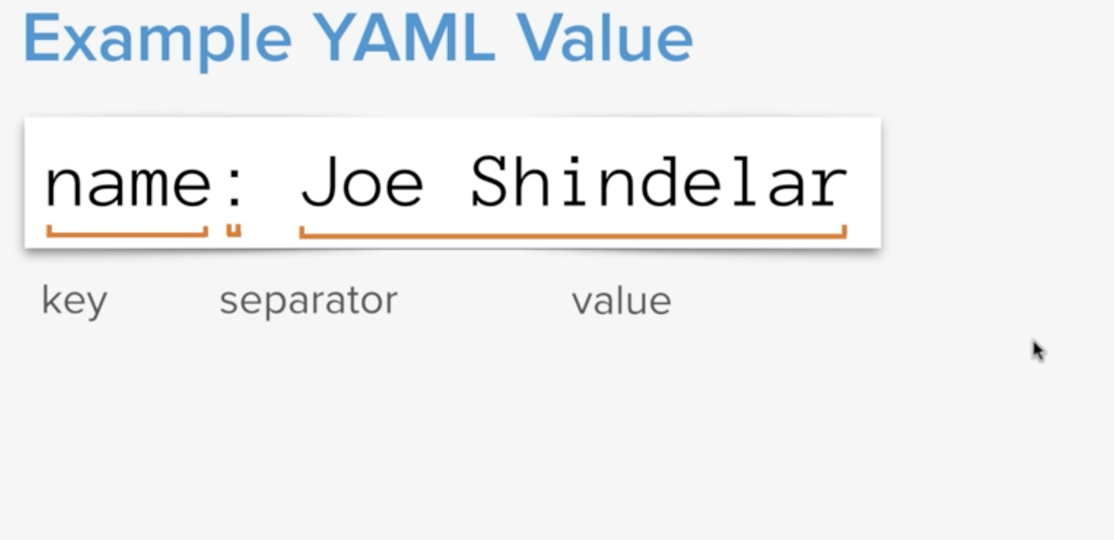
Syntax of YAML value

Slide 20
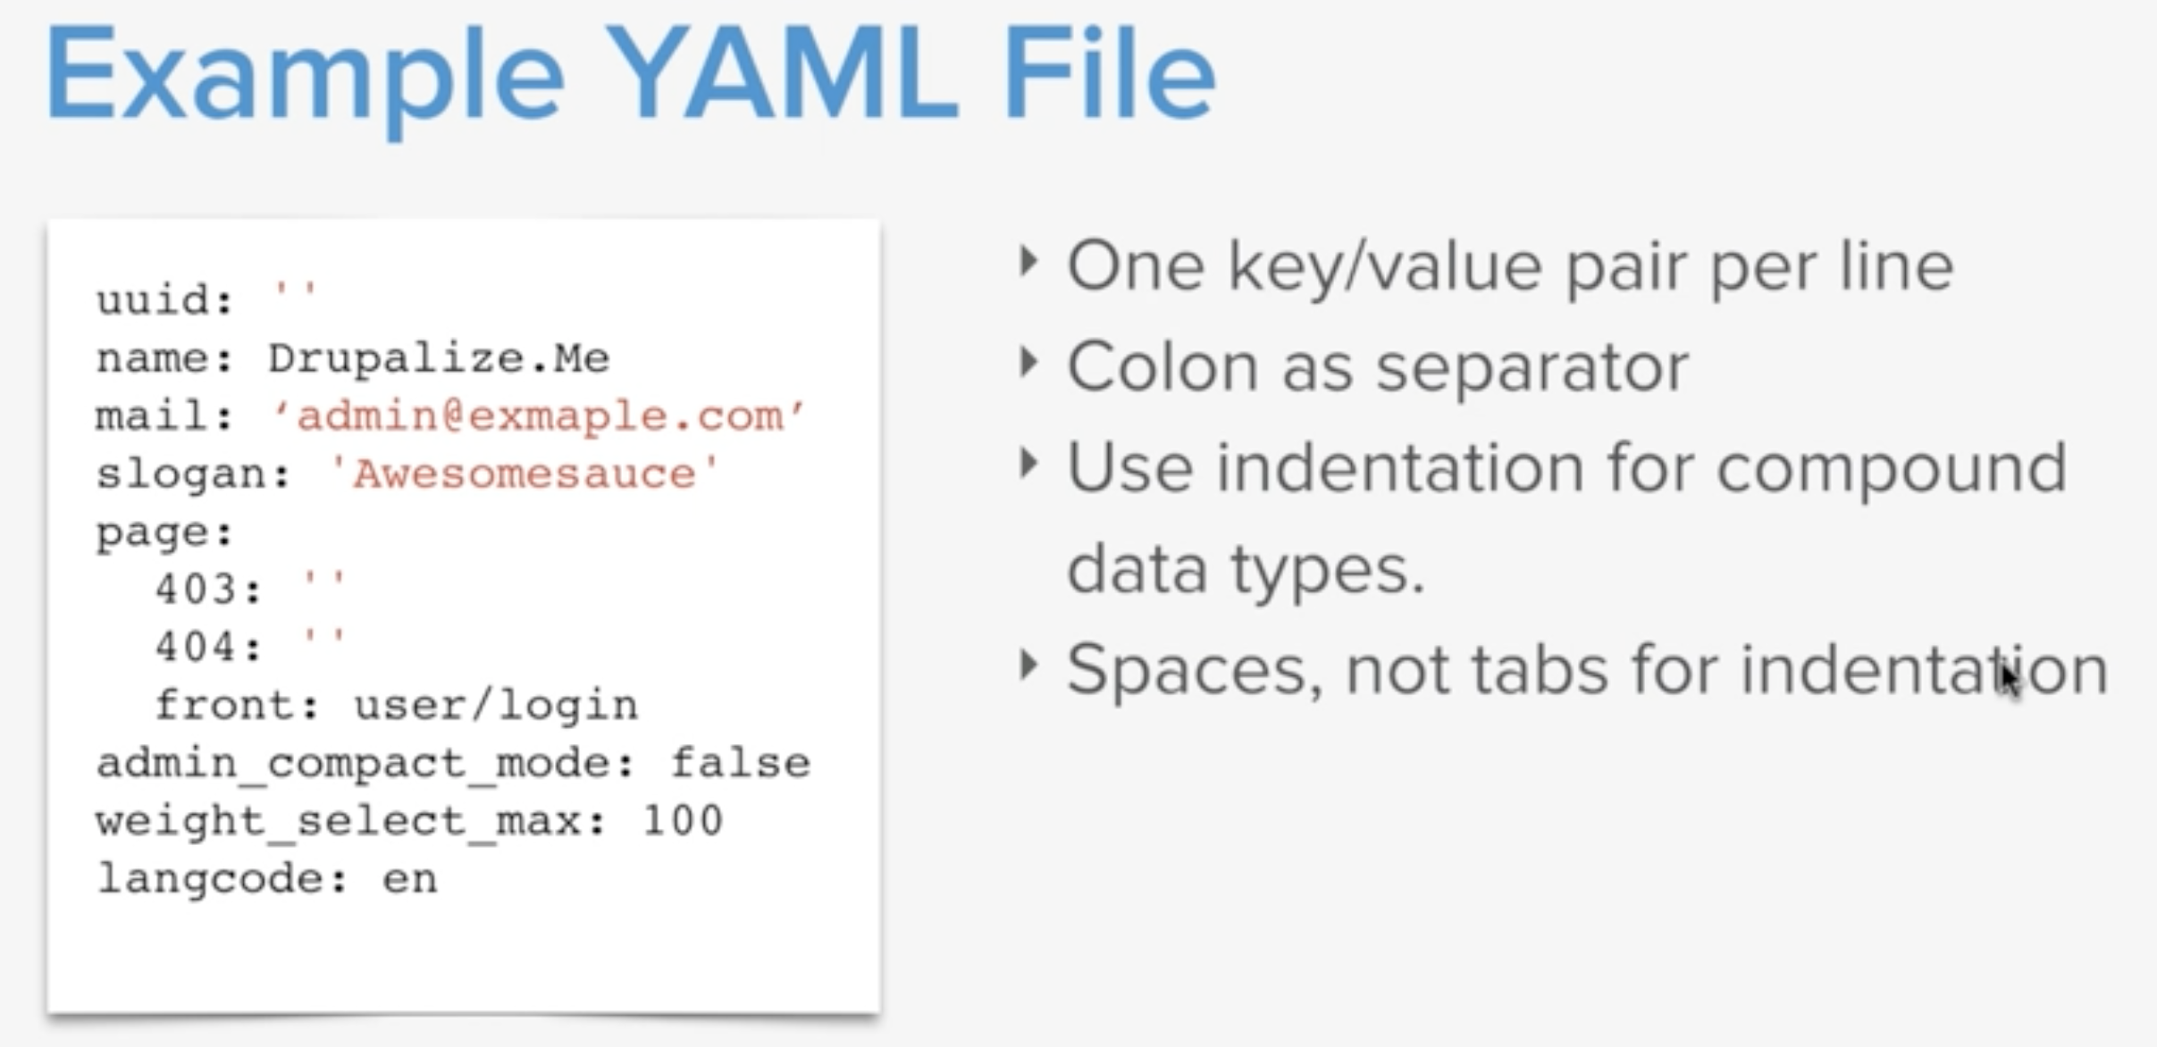
Example of YAML value

Slide 21
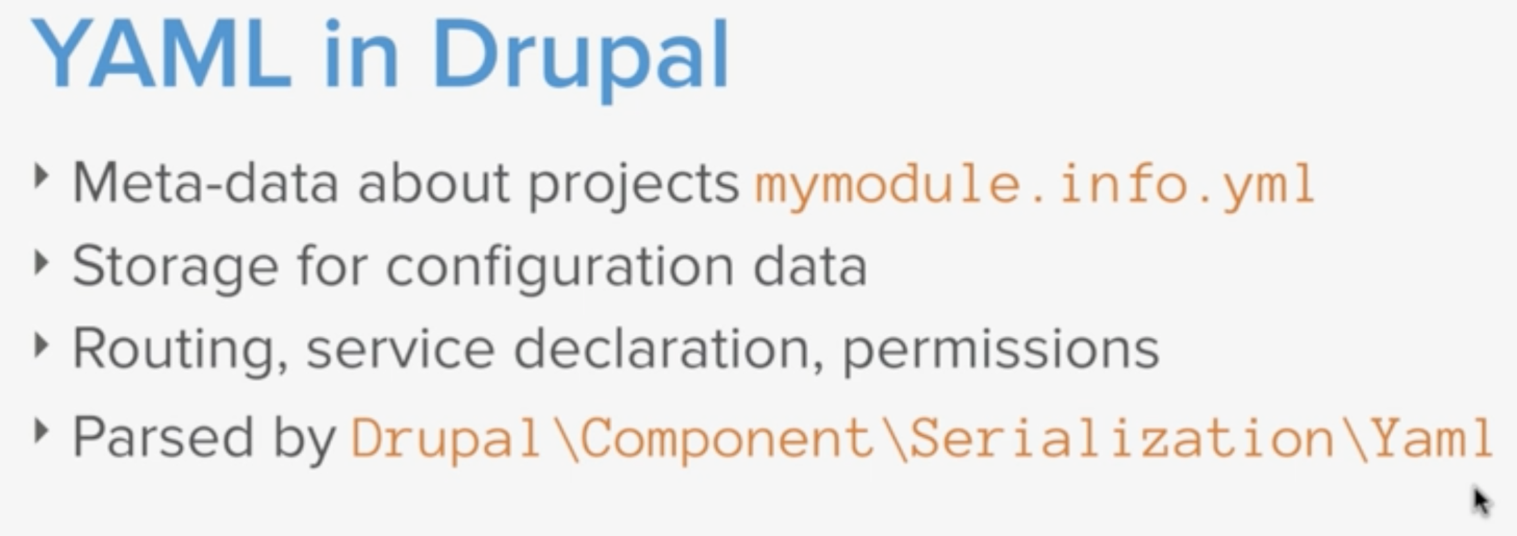
YAML in Drupal
Notes:
Yaml.org

Slide 22
Example of YAML value

Slide 23
What are Drupal Code Standards?
What
Why
Where
Coding standards are a set of rules for programmers that lay out best practices, formatting, and various other rules. Think of it as the MLA style guide for programming. It tells us how to format what we write, so that everyone is using the same conventions.
Notes:
https://owl.purdue.edu/owl/research_and_citation/mla_style/mla_formatting_and_style_guide/mla_formatting_and_style_guide.html

Slide 24
What are Drupal Code Standards?
Style
There are code standards that tell you how to style and format your code, which are mostly concerned with how it looks and how it will be read. This includes things like indentation, whitespace, and line length. Ensuring that all code adheres to the same style gives the whole Drupal project a sense of coherence, and makes it easier for developers to read other people's code.
Notes:
https://owl.purdue.edu/owl/research_and_citation/mla_style/mla_formatting_and_style_guide/mla_formatting_and_style_guide.html

Slide 25
What are Drupal Code Standards?
Substance
There are also code standards that inform the actual content and substance of your code. These standards include instructions for the use of various functions and components in your code.
https://paul-m-jones.com/post/2004/09/23/why-coding-standards-matter/
Keep code readable
When coding standards are followed, your code and your teammates' code can be read the same way. You can review their code and know what to expect, and they can review yours. If you post a contrib module, someone from around the world can read, maintain, and modify your code. In a community like Drupal, this is essential.
Notes:
https://owl.purdue.edu/owl/research_and_citation/mla_style/mla_formatting_and_style_guide/mla_formatting_and_style_guide.html

Slide 26
What are Drupal Code Standards?
Automation
Code standards are especially important in Drupal documentation, because the API module automatically parses the information to generate documentation, which you can view at https://api.drupal.org/api/drupal. You can even set up your own API documentation site.
If your code adheres to standards, you can check it with PHP_CodeSniffer, which can even be automated with Travis CI so that every pull request you make is checked for accuracy. The cleaner your code, the less work you have to do, and the more you can automate!

Slide 27
What are Drupal Code Standards?
Who decides what coding standards are?
Drupal's standards are based on the PEAR coding standards, but other than that, they are decided in an issue queue on Drupal.org. Someone brings up an issue, suggests a solution, the group talks it over, and when they come to a consensus, we've got a new standard.

Slide 28
Explore and Read the docs
Your task now is to go through the Drupal site and read the docs for 10-15 minutes https://www.drupal.org/docs/develop/standards
https://pear.php.net/manual/en/standards.php

Slide 29
Twig in Drupal
Twig is the default template engine for Drupal. If you want to make changes to the markup that Drupal outputs you're going to need to know at least some Twig.
What is Twig?
Twig is a template engine for PHP.
A template engine allows an application or system like Drupal to separate the concerns of functional “business logic” and the presentation or markup of the resulting data.

Slide 30
Twig in Drupal
With Twig, there are 3 syntax delimeters:
{{ say something }}
{% do something %}
{# comment on something #}
Why Twig in Drupal?
Twig was adopted in Drupal as a replacement for PHP template for a number of reasons including:
Improved security
Twig introduces autoescaping and sanitizes all HTML to prevent XSRF attacks.
PHP will not be executed in a Twig file and will display instead as plain text.
Previous major versions of Drupal executed any PHP and made it hard to know what user input was escaped.

Slide 31
Drupal Code Standards: Twig
Twig is the theme template engine in Drupal as of version 8. Like any code, there are guidelines and standards that dictate both the style and the structure of the code.
The docblock
Variables
Expressions
Attributes
Whitespace control
Filters
Comments
Syntax
https://twig.symfony.com/doc/2.x/coding_standards.html
Notes:
https://www.drupal.org/docs/theming-drupal/twig-in-drupal/twig-template-naming-conventions

Slide 32
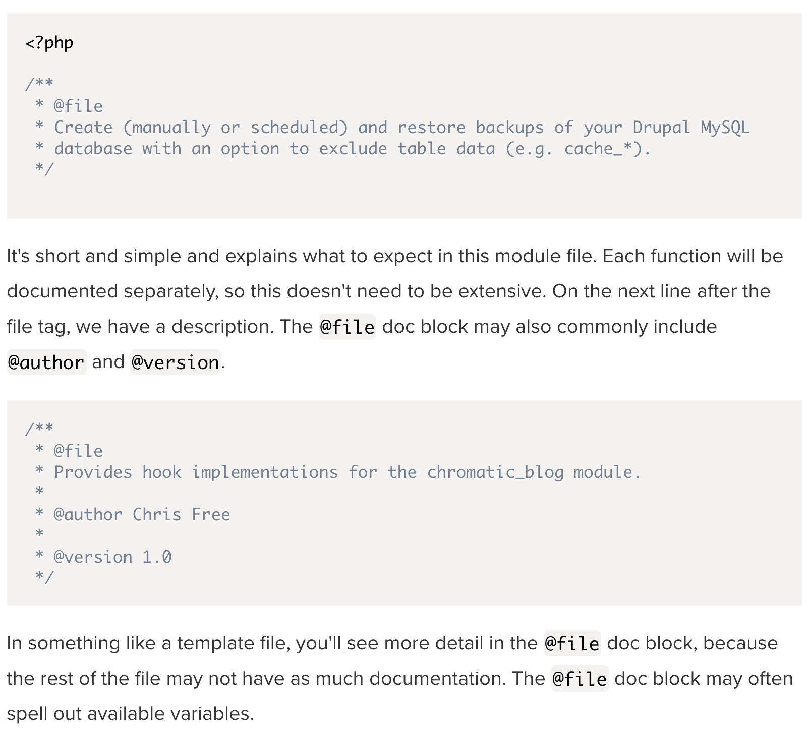
Twig: The docblock – File doc blocks
Notes:
https://www.drupal.org/docs/theming-drupal/twig-in-drupal/twig-template-naming-conventions

Slide 33
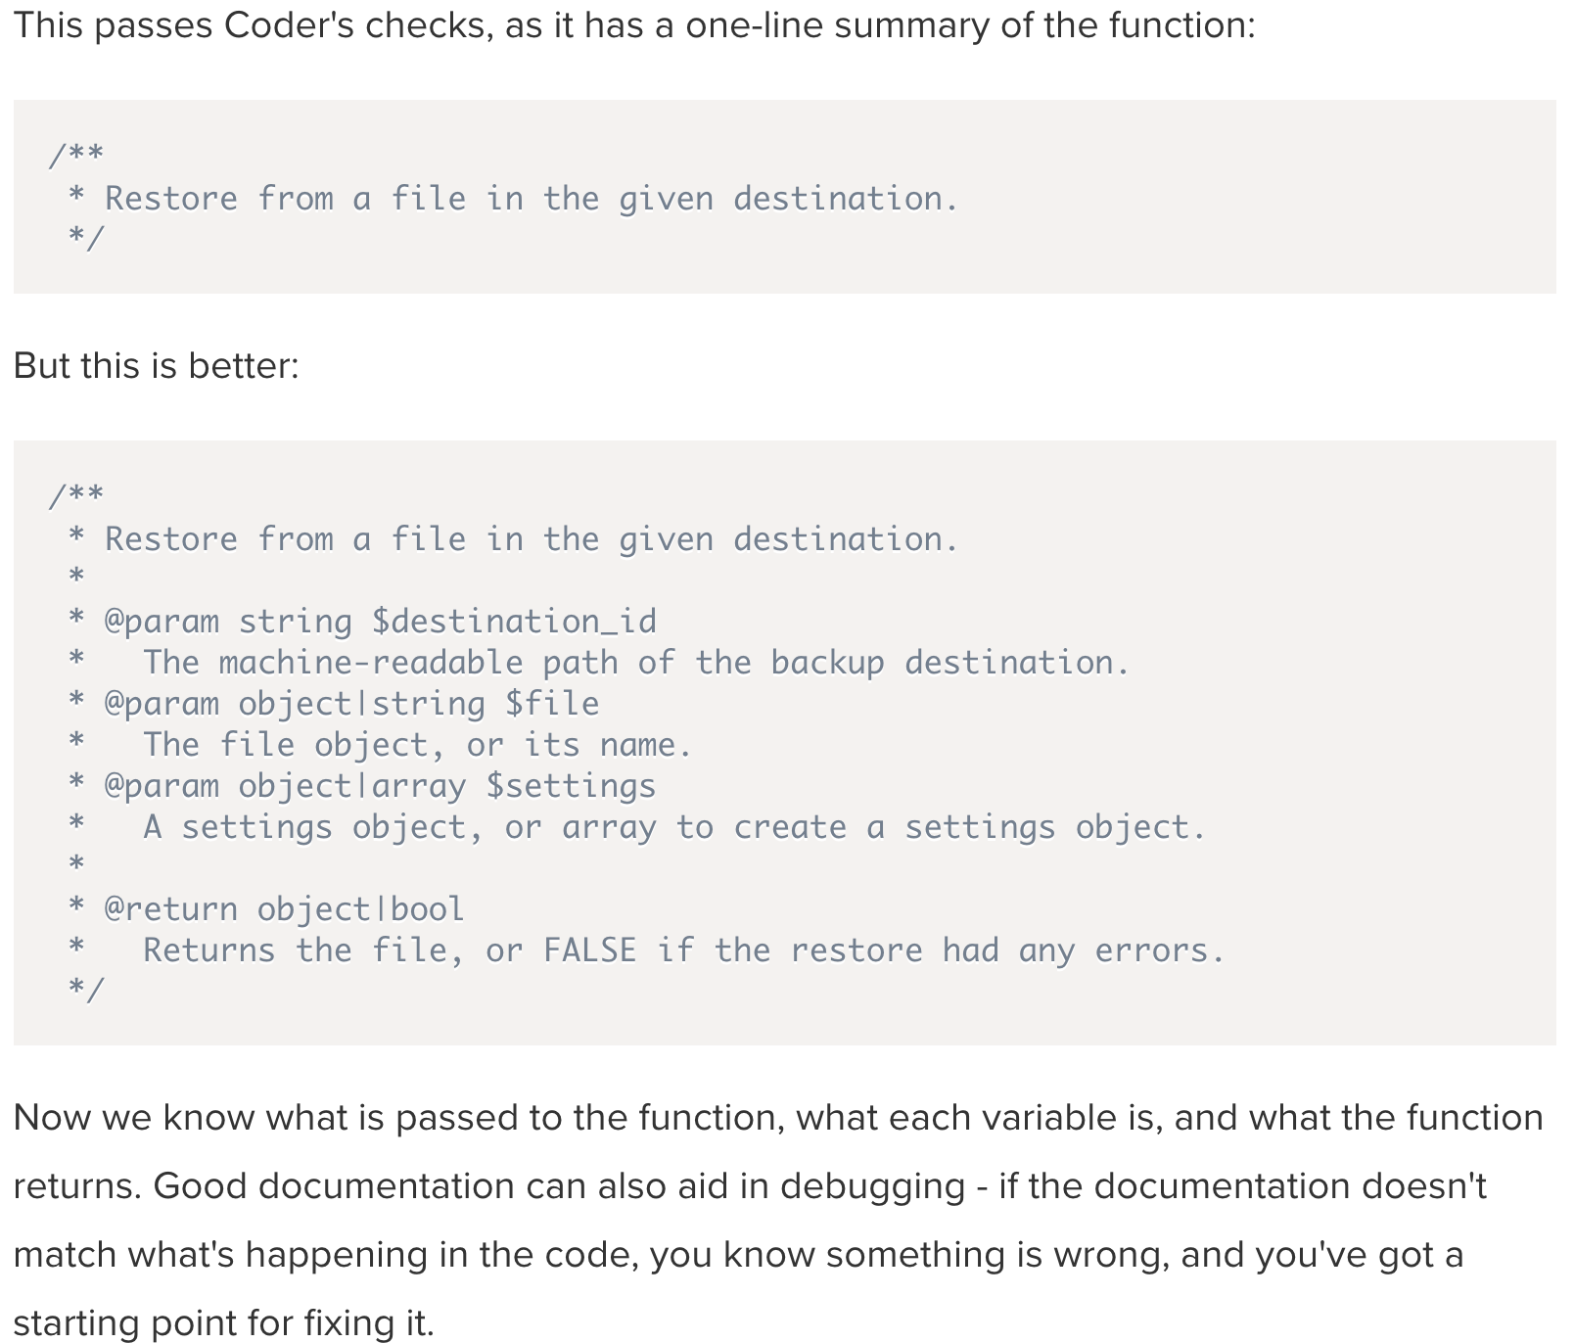
Twig: The docblock – Function doc blocks
Notes:
https://www.drupal.org/docs/theming-drupal/twig-in-drupal/twig-template-naming-conventions

Slide 34
Twig: Tag doc blocks
There are a variety of tags you can use in your doc blocks to indicate what this documentation is about, and they're expected to go in a certain order, as follows:
One-line summary, ending in a period, preferably 80 characters or fewer
Additional paragraph(s) of explanation wrapped at 80 characters
@var: Document a variables data type
@param: Document parameters for a function or method
@return: Document return values for a function or method
@throws: Document exceptions thrown
@ingroup: Indicate this code belongs to a @defgroup topic
@deprecated: Indicate that this code has been deprecated
@see: Reference related code or topics
@todo: List of known to-do items related to a block of code
@Plugin and other annotations
Notes:
https://www.drupal.org/docs/develop/standards/api-documentation-and-comment-standards#order

Slide 35
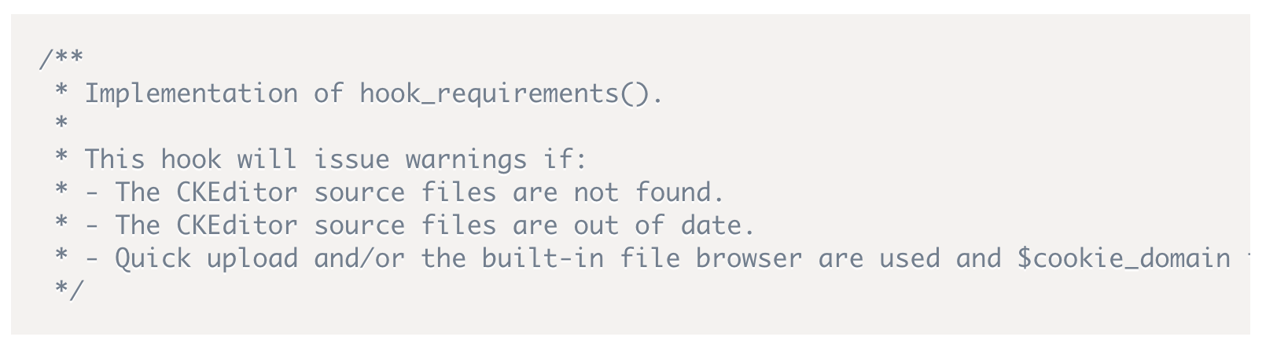
Twig: Lists doc blocks
You can create lists in your doc blocks that will be interpreted by the API module as unordered lists. They can also make it easier to read. Start the line with a hyphen to indicate a list item.
Here is an example from the CKEditor module:
Notes:
https://www.drupal.org/docs/develop/standards/api-documentation-and-comment-standards#order

Slide 36
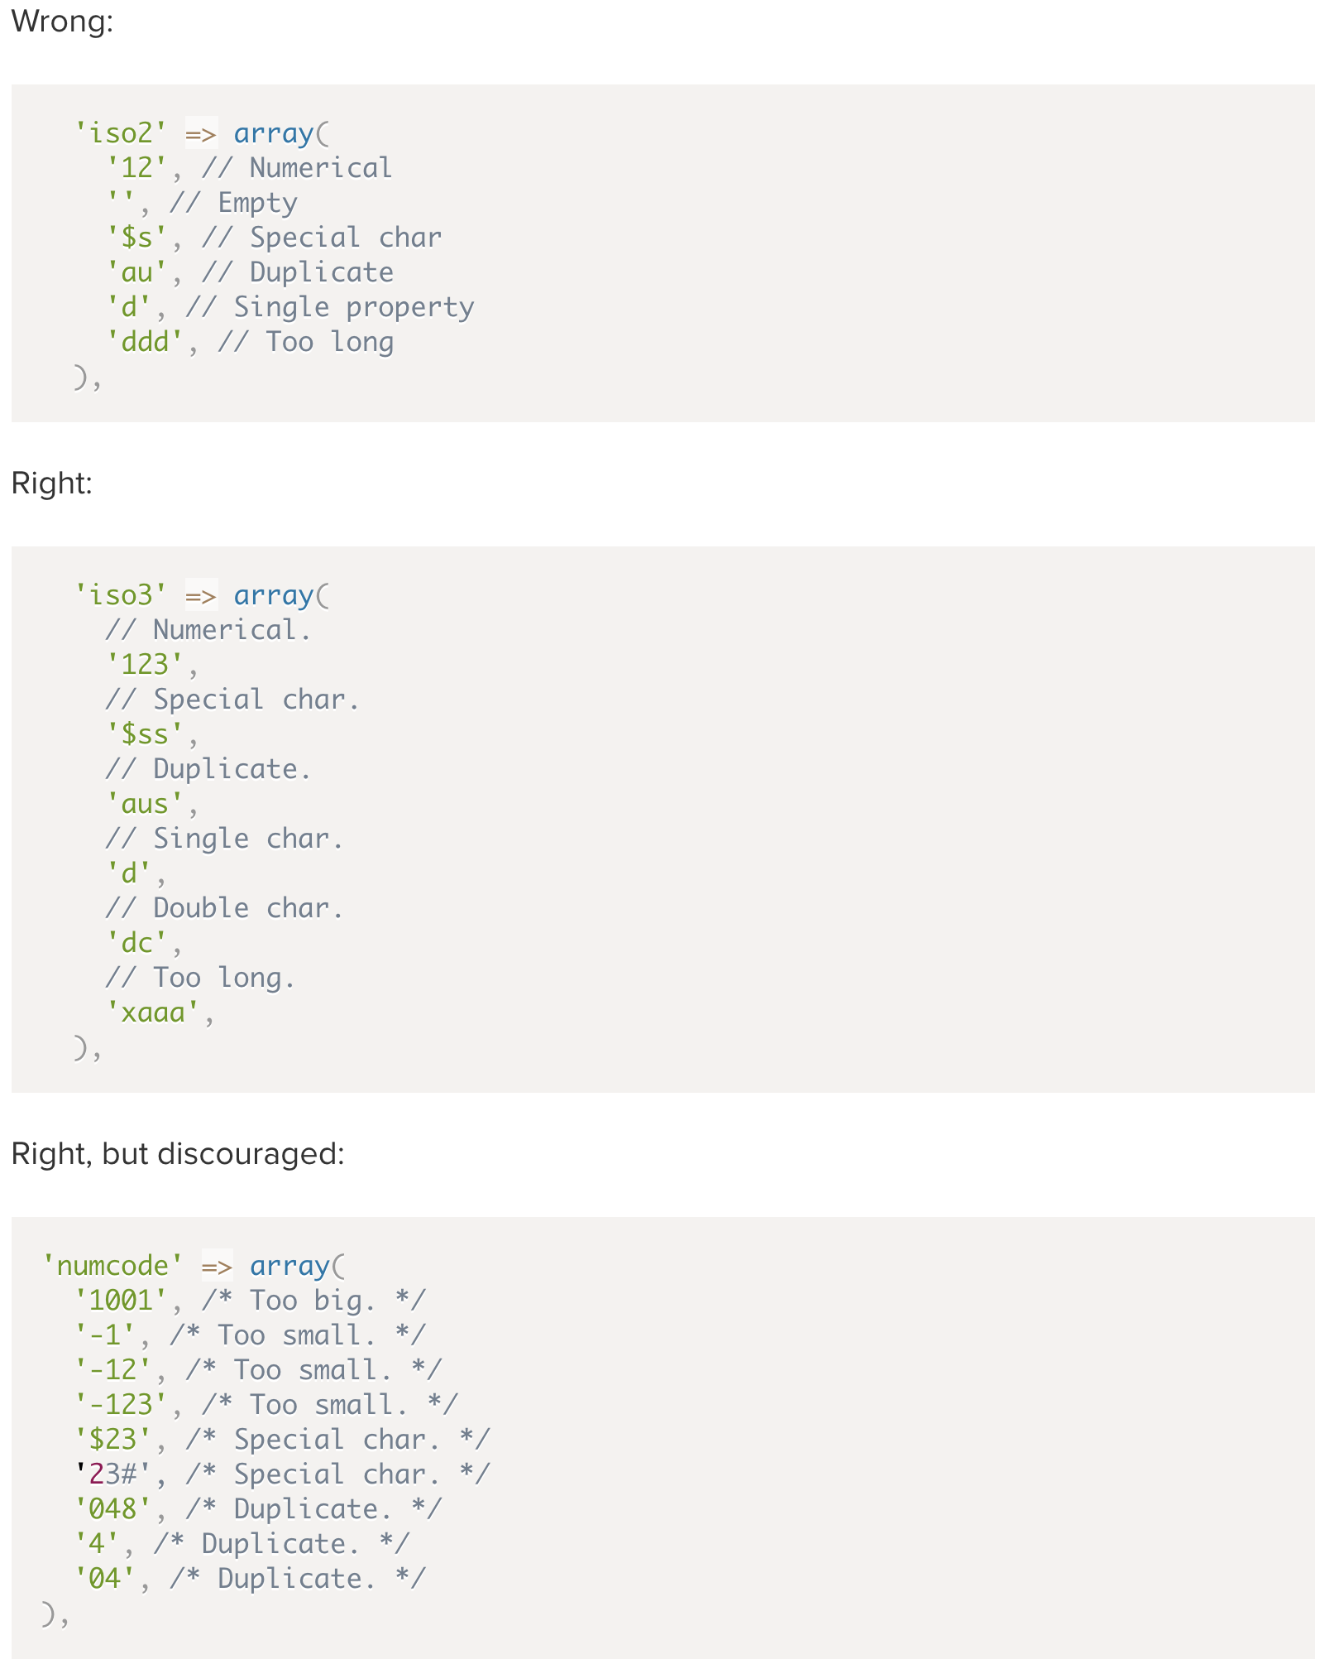
Twig: Inline comments
Remember that inline comments must always end with a period and must never be longer than 80 characters.
Notes:
https://www.drupal.org/docs/develop/standards/api-documentation-and-comment-standards#order

Slide 37
Practice: Read the docs
Your task now is to go through the Drupal site and browse the links
https://www.drupal.org/docs/develop/standards/api-documentation-and-comment-standards#templates
https://www.drupal.org/docs/develop/standards/api-documentation-samples
About PhpCodesniffer
https://chromatichq.com/insights/learn-and-enforce-coding-standards-php-codesniffer
https://github.com/squizlabs/PHP_CodeSniffer

Slide 38
Structure of a Theme
Each theme is a collection of files that define a presentation layer for Drupal.
While only a THEMENAME.info.yml file is required, most themes will contain other files as well.
Where should your themes go so Drupal can find them?
Each theme is contained within a single directory. The directory name should match the theme's unique name.
If your theme is named icecream, your theme's code would all lives within the directory icecream/.
The name must be all lowercase, start with a letter, and use an underscore (_) instead of spaces.

Slide 39
Structure of a Theme
Themes that you develop yourself, or any that you download from Drupal.org should be placed in the themes/ folder in the root of your Drupal project.
Additionally, I recommend further sub-dividing the themes/ folder into themes/contrib/ for all themes downloaded from drupal.org, and themes/custom/ for your own custom themes.
Placing your custom themes in the root themes/ directory instead of the core/themes/ directory ensures that when you need to update Drupal core you can replace the contents of the core/ directory without worrying about losing any of your personal additions.

Slide 40
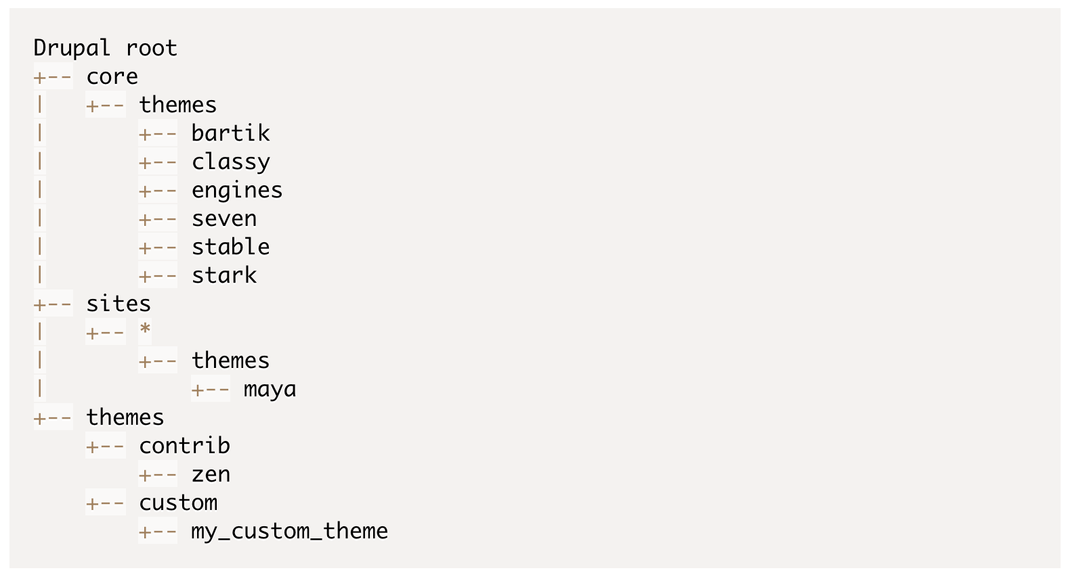
Structure of a Theme

Slide 41
Practice 13: Install a “devel” module
From Extend menu, check if you have ‘’devel” module installed
If not installed, download using lando composer https://www.drupal.org/project/devel
Install the module from Extend menu
Once installed, enable it from that Extend menu
Go to web profiler and enabled it.
In web profiler menu, you can click on Configure
Check the boxes for Events, Routing and Services
Save
Click on any icon in the toolbar it will go to new section called profiler

Slide 42
Create a simple custom theme
Go to VS code and under themes folder, create a custom folder
Name your theme e.g. icecream_theme
Under icecream_theme folder, create a new icecream_theme.info.yml file
Review the required key/value pairs of an .info.yml file
Go to configuration→performance→Clear all cache
You can see your new custom theme from Appearance
Enable our new custom theme and set it as default
You will see how beautiful theme we created
Notes:
drupal generate:theme

Slide 43
Create a simple custom theme
You can add some styles
Create a new file e.g. icecream_theme.libraries.yml
You will need to tell info file that we created a libraries
So add inside info.yml file
e.g. libraries:
- icecream_theme/global
Create a folder called css under your icecream_theme folder
Inside css folder, create a global.css file
Add some trivial css
Clear cache and see how your theme is updated
Also inspect the with inspector
You can use theme generators to create theme more quickly
https://www.drupal.org/project/rocketship_theme_generator
Notes:
drupal generate:theme

